Slide 1
Training Management

Slide 2
Training Management
Group 7-Team Members
16210 Umesh Kumar Toke
16110 Lokesh Nehete
16170 Geetanjali Kulkarni
16083 Abhinav Anand
16170 Hemant Bhosale
16206 Subhashini Asthana

Slide 3
Introduction –By Umesh Toke

Slide 4
Resource File – By Hemant

Slide 5
Database Schema –By Geetanjali

Slide 6
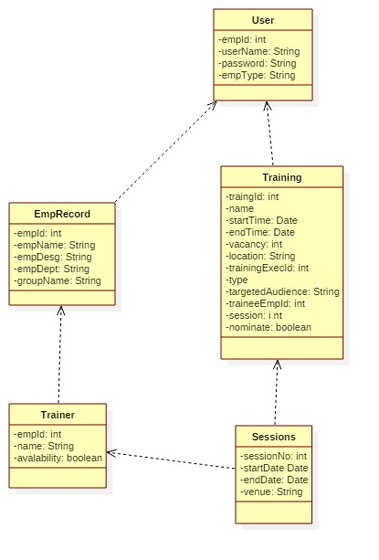

Slide 7
Login Module-By Abhinav Anand

Slide 8
Sessions and Cookies-Hemant

Slide 9
Register Training-By Umesh Toke

Slide 10
Delete Training-By Subhashini

Slide 11
Mandatory training-By Abhinav Anand

Slide 12
Future training-By Subhashini

Slide 13
Trainers training- By Lokesh Nehete

Slide 14
Logout-By Hemant

Slide 15
Thank You!

